Slide 1
Secure Data Hiding in Image Using Steganography
CAPSTONE PROJECT
Presented By :
Student Name : Abhinav Aher.
College Name : Progressive Education Society’s Modern College of Engineering, Pune : 05
Department : Computer Engineering

Slide 2
OUTLINE
Problem Statement
Technology used
Wow factor
End users
Result
Conclusion
Git-hub Link
Future scope

Slide 3
Problem Statement
Implement image steganography in Java, allowing users to hide and retrieve a secret message within an image. The program reads an image file, encodes a message by modifying pixel values, and saves the encrypted image. Upon entering the correct passcode, the hidden message is extracted. However, the current implementation has issues, such as JPEG compression loss, lack of message length storage, and a weak encoding strategy. To improve reliability, the program should use PNG format, implement Least Significant Bit (LSB) encoding, and integrate XOR encryption with the passcode for better security and accuracy.

Slide 4
Technology used
Programming Language: Java.
Libraries:Java AWT (image processing), Swing (user input handling), BufferedImage (image manipulation).
Encryption Method: Pixel-value encoding by modifying RGB channels to store message characters.
Platform Compatibility: Windows, Linux.
Image Format Support: PNG, JPG, JPEG.
Error Handling & Validation: Input validation, exception handling for unsupported formats, incorrect passcodes, and excessive message length to prevent data corruption and unauthorized access.
4o

Slide 5
Wow factors
Stealth & Security:Hidden data is stored in pixel values and can only be retrieved with the correct passcode.
GUI-Based Implementation: Operates via a command-line interface for encoding and decoding messages.
Multi-Layered Security: Requires a passcode for decryption, but it does not influence the encryption process.
Minimal Image Distortion: Direct RGB modifications may alter the image; using PNG minimizes data loss.
Scalability: Can be enhanced with LSB encoding, improved encryption, and broader format support.

Slide 6
End users
Cybersecurity Experts: Experiment with basic steganography for secure data hiding.
Journalists & Activists: Learn about image-based data encoding and retrieval techniques.
Military & Intelligence Agencies:Explore Java-based image manipulation and encryption methods.
Privacy-Conscious Individuals: Store hidden messages within images for personal security.

Slide 7
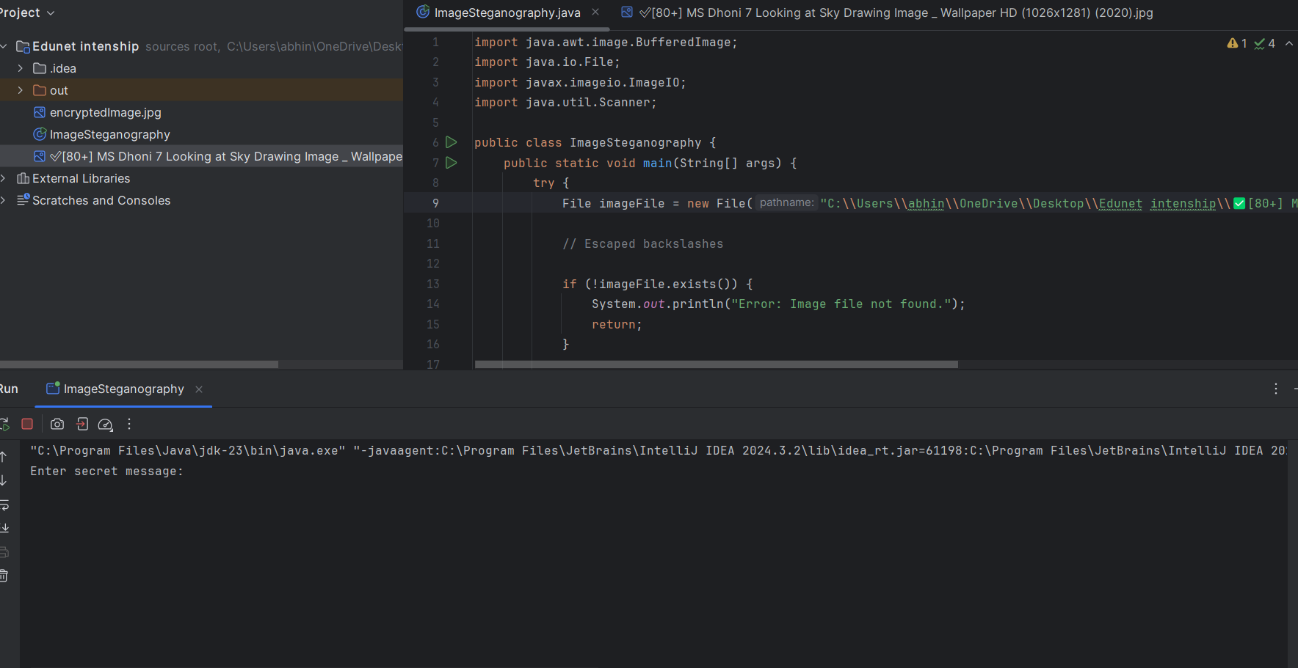
Results
Fig 1 : Entering the message .

Slide 8
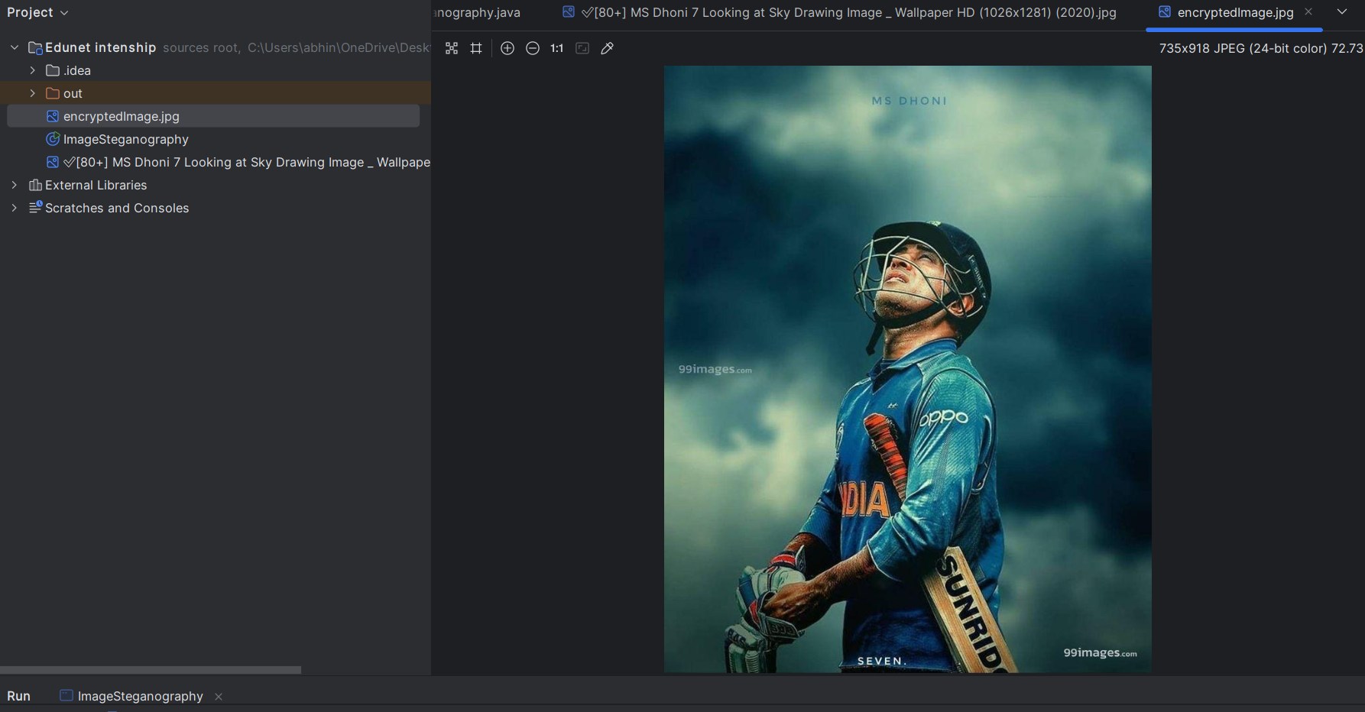
Results
Fig 2 : Encrypting Image
As visible in the image, original image is encrypted with the message and a new encrypted image is generated.

Slide 9
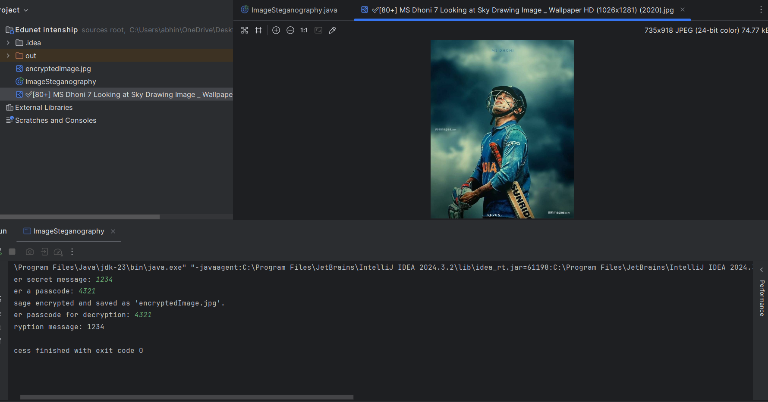
Results
Fig 3 : Decrypting Image
As visible in the image, we need to select the encrypted image using browse button and decrypt the message included in the image.

Slide 10
Conclusion
This project demonstrates a basic approach to hiding and retrieving data within digital images using Java. By modifying pixel values, it embeds messages while preserving the image’s overall appearance. The console-based implementation allows users to encrypt and decrypt messages with a passcode for added security. However, improvements such as Least Significant Bit (LSB) encoding, stronger encryption, and broader format support can enhance security and efficiency. Future enhancements could include a graphical user interface (GUI) for better usability, making steganography more accessible while ensuring greater data protection and adaptability across different platforms and use cases.

Slide 11
GitHub Link
https://github.com/Abhi-240504/Steganography_cyber_S_Aicte.git

Slide 12
Future scope(optional)
Optimized Steganography: Implement Least Significant Bit (LSB) encoding for more secure data hiding.
Support for Additional Formats: Extend compatibility beyond PNG and JPG for better versatility.
Stronger Encryption Methods: Integrate XOR-based encryption with the passcode for added security.
GUI Implementation: Develop a user-friendly interface for easier message embedding and retrieval.
Steganalysis Resistance: Improve encoding techniques to minimize detection and unauthorized access.
4o

Slide 13
THANK YOU merci | Gracias | Danke

